Slide 1
Channel Access Clients
Kay Kasemir
Jan. 2019

Slide 2
Channel Access Operations
‘connect’
‘get’, ‘get-callback’, ‘monitor’
‘put’, ‘put-callback’
‘disconnect’

Slide 3
‘connect’
Based on channel name, UDP search, ..
See earlier Channel Access overview
Connection might take a few seconds
Network interruptions do happen
CA client libraries will automatically re-connect
API for being notified about connect/reconnect

Slide 4
‘disconnect’
A long-running program might
Connect PVs ”A”, “B”, “C”, use them for a while, disconnect
Connect PVs ”X”, “Y”, “Z”, use them for a while, disconnect
Cleanup resources on the CA server/IOC, reduce network traffic
Quick and dirty script may just connect, use, quit

Slide 5
‘get’, ‘get-callback’, ‘monitor’ - read, subscribe
‘get’
Request value
Wait for value (with timeout of ~ seconds)
‘get-callback’
Request value
Callback invoked once as value arrives
‘monitor’
Register for updates
Callback invoked whenever a value arrives, until monitor cancelled

Slide 6
‘put’, ‘put-callback’ - write
‘put’
Send a value
Error in case channel not connected right now, or no write access. Otherwise done.
‘put-callback’
Send a value
Callback invoked once the value has been received by CA server and ‘completed’. For PV related to motor record on IOC, this can mean motor drive has been energized, motor moved to appropriate target location, then performed N adjustments to perfectly reach the desired position, and finally motor drive was de-energized.

Slide 7
Higher Level CA Client Bindings
Cached PVs
When first asked for a channel, some PV object is created which connects and tracks connection state.
When your program later asks for the same PV, it gets that cached PV which is already connected
Subscribed
PV always monitors. If you read the value of a PV, you get the most recent monitor right away
Write
Writing a PV tends to be the plain ‘put’, a fire-and-forget that doesn’t delay your program and will eventually reach the CA server/IOC
➔ Convenient and performant for most clients

Slide 8
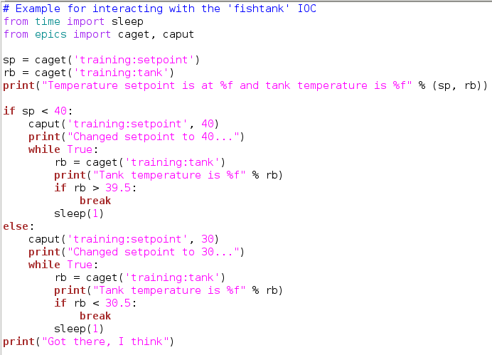
Python Example

Slide 9
Automation: This doesn’t cut it
write 10 to ”motor:setpoint” read detector data
save data in file for “position10”
Your motor might still be moving while you take data

Slide 10
Automation: Not ideal, either
write 10 to ”motor:setpoint” while abs(read(“motor:position”) – 10) < 0.1: sleep 1 second
# OK, we’re at the desired position read detector data
save data in file for “position10”
Maybe, maybe not

Slide 11
Automation: How do you know you’re “done”?
Temp, pos, …
Setpoint
Readback
done?
done?
done!
Time

Slide 12
Automation: Use ’put-callback’
Only logic on IOC really knows when it’s done
Motor record: Performed initial backlash-compensated move, then retries, now motor is at rest and we’re “done”
Lakeshore controller: Calc records, busy record, sequence knows when it’s “done”
With ‘put-callback’, IOC will tell you when it’s “done”
Alas, no way to tell from the outside if a PV actually supports put-callback. If not, put-callback returns right away even though the device is not “done”.

Slide 13
Automation: Use explicit ‘get’, ‘get-callback’
In a higher level library, ‘PV.read()’ might only tell you about the last received monitor. The actual record might have a new value that you will soon receive via a monitor, but unclear when exactly. Based on MDEL, you might never get the exact value.
Explicit ‘get’ or ‘get-callback’ will force a round-trip read/response, fetching the most recent value.

Slide 14
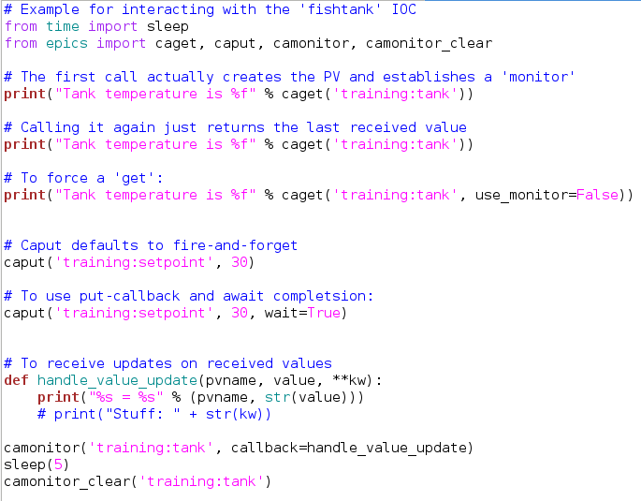
Another Python Example

Slide 15
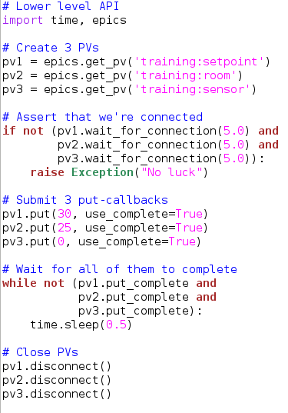
Yet Another Python Example
More: https://github.com/pyepics/pyepics

Slide 16
Other CA Client Options
Python ‘PVA’ client for the new PVAccess Protocol
Supports “CA Transport”, so new API for both CA and PVA
Matlab/Octave/Scilab MCA resp. LabCA bindings
SNL/Sequencer
Display Builder scripts
Plain C code calling CA.lib
Plain Java code calling JCA.jar

Slide 17
Summary
Higher level bindings like python are pretty easy:
caget, caput
For dependable automation, remember get/put-callback

